Slide 1

Topic: Congruency
EQ: What types of transformations
can congruent figures undergo?

Slide 2
5 Questions
Topic: Congruency
EQ: What types of transformations can congruent figures undergo?
1. Take bought a pair of shoes for $150. He sold them
for $175. What %profit did he make?
2. Which is the better buy: 2kg of cheese for $15.60 or 1.5kg of cheese for $13.00?
3. What are the 5 tests for congruency in triangles?
4. What is the definition on reflection?
5. Complete your summary from last lesson.

Slide 3
Quickwrite
Spend two minutes writing down things that are identical. What things are identical in nature? On your body? In this classroom?
After two minutes we’ll share some of them on the board

Slide 4
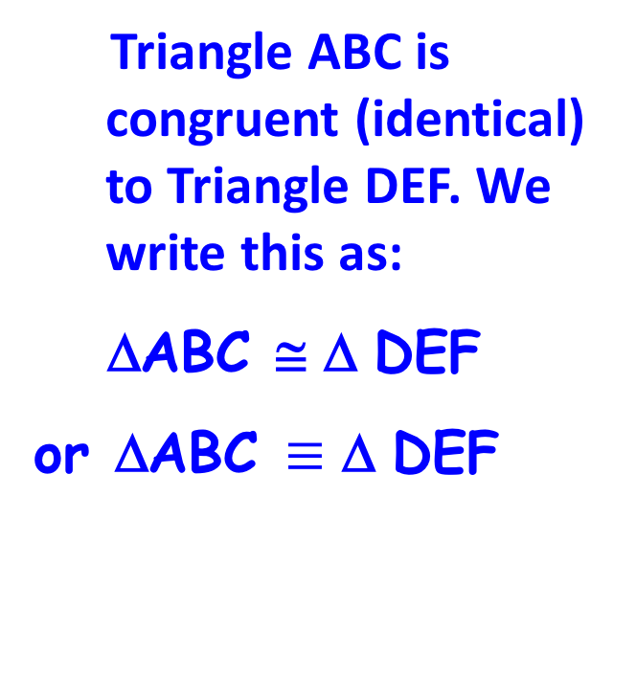
24
7
30
Date
Congruency
EQ – What types of transformations can congruent figures undergo?
Congruent shapes have the same shape and size. They can fit exactly on top of each other
F
Triangle ABC is congruent (identical) to Triangle DEF. We write this as:
ΔABC ≅ Δ DEF
or ΔABC $≡$ Δ DEF
B
A
C
E
D
Summary -

Slide 5
Congruency in Real life Video (90 seconds)
https://www.youtube.com/watch?v=aejEwpxfKu8

Slide 6
Which of these shapes are congruent?

Slide 7
Your turn - Which of these shapes are congruent to the yellow one?
1
4
3
2
5
7
6
8

Slide 8
Congruent shapes are all shown in yellow – were you right?
1
4
3
2
5
7
6
8

Slide 9
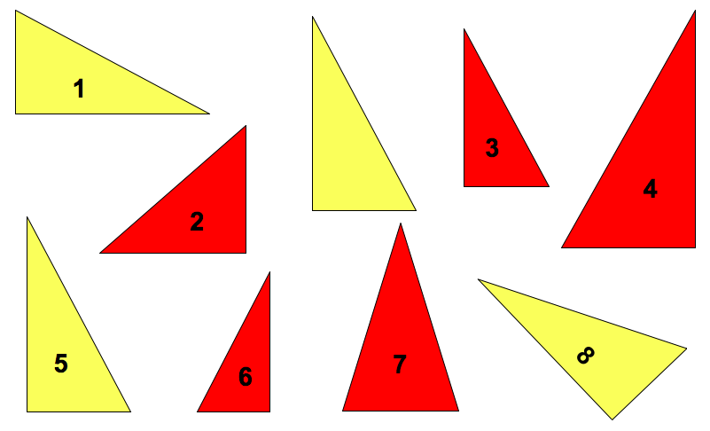
24
7
30
Date
Congruency
EQ – What types of transformations can congruent figures undergo?
The congruent shapes in yellow are in different positions. They have been transformed, which occurs in 3 ways:
Summary -

Slide 10

Types of Transformations
24
7
30
Date
Congruency
EQ – What types of transformations can congruent figures undergo?
Reflections: These are like mirror images as seen across a line of symmetry.
Translations (or slides): This moves the figure to a new location with no change to the looks of the figure.
Rotations: This turns the figure clockwise or counter-clockwise but doesn’t change the figure.
Summary -

Slide 11
Translation Videos: One Educational, the other Catchy (annoyingly catchy)!
https://www.youtube.com/watch?v=DMLOzPEzrfA
Or
https://www.youtube.com/watch?v=0Z1aUhGCZs0

Slide 12
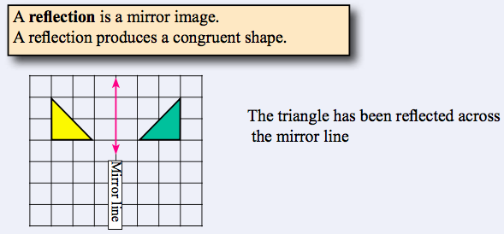
24
7
30
Date
Congruency
EQ – What types of transformations can congruent figures undergo?
Summary -

Slide 13
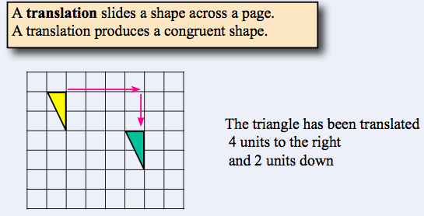
24
7
30
Date
Congruency
EQ – What types of transformations can congruent figures undergo?
Summary -

Slide 14
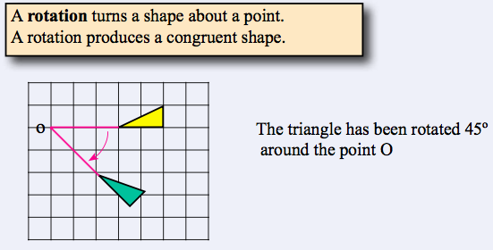
24
7
30
Date
Congruency
EQ – What types of transformations can congruent figures undergo?
Summary -

Slide 15
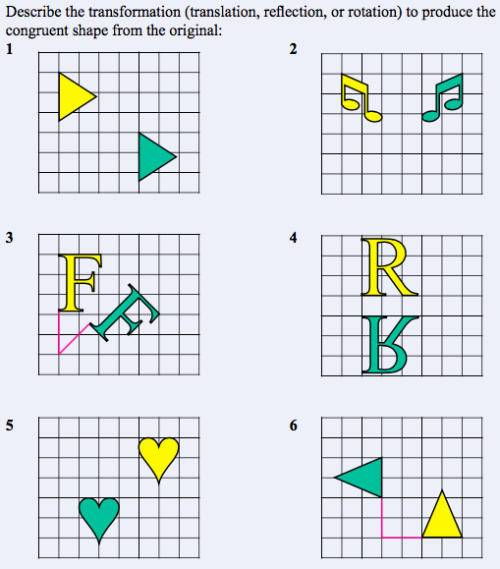

Slide 16
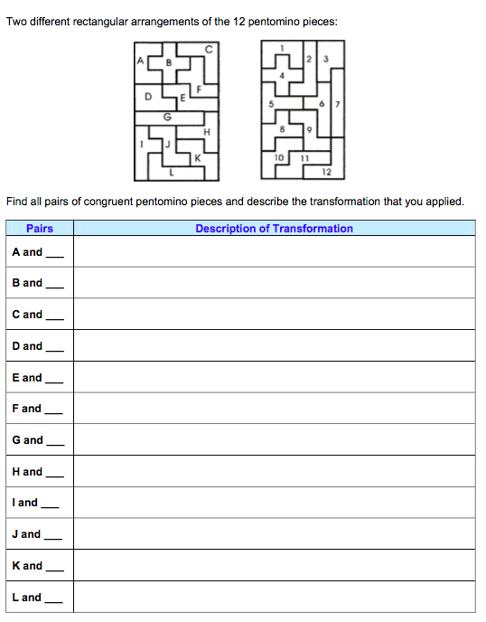

Slide 17

Do you understand? Fists of Five
Good, now fill out your Summaries!
Notes:
Check for Understanding

Slide 18
Notes Review
24, 7 ,30
Date
Title
Essential question
Notes complete
Notes complete with colour and diagrams
Questions completed
Contents page filed in
Formula page filled in

Slide 19
Homework
Review your notes and write a summary answering the essential question.

